Slide 1
Advanced aggregation

Slide 2
$lookup

Slide 3
$lookup
$lookup implements joins between MongoDB collections
Technically, it’s a LEFT OUTER JOIN
Can perform very poorly if without appropriate indexes
(See https://medium.com/mongodb-performance-tuning/coding-efficient-mongodb-joins-97fe0627751a)

Slide 4
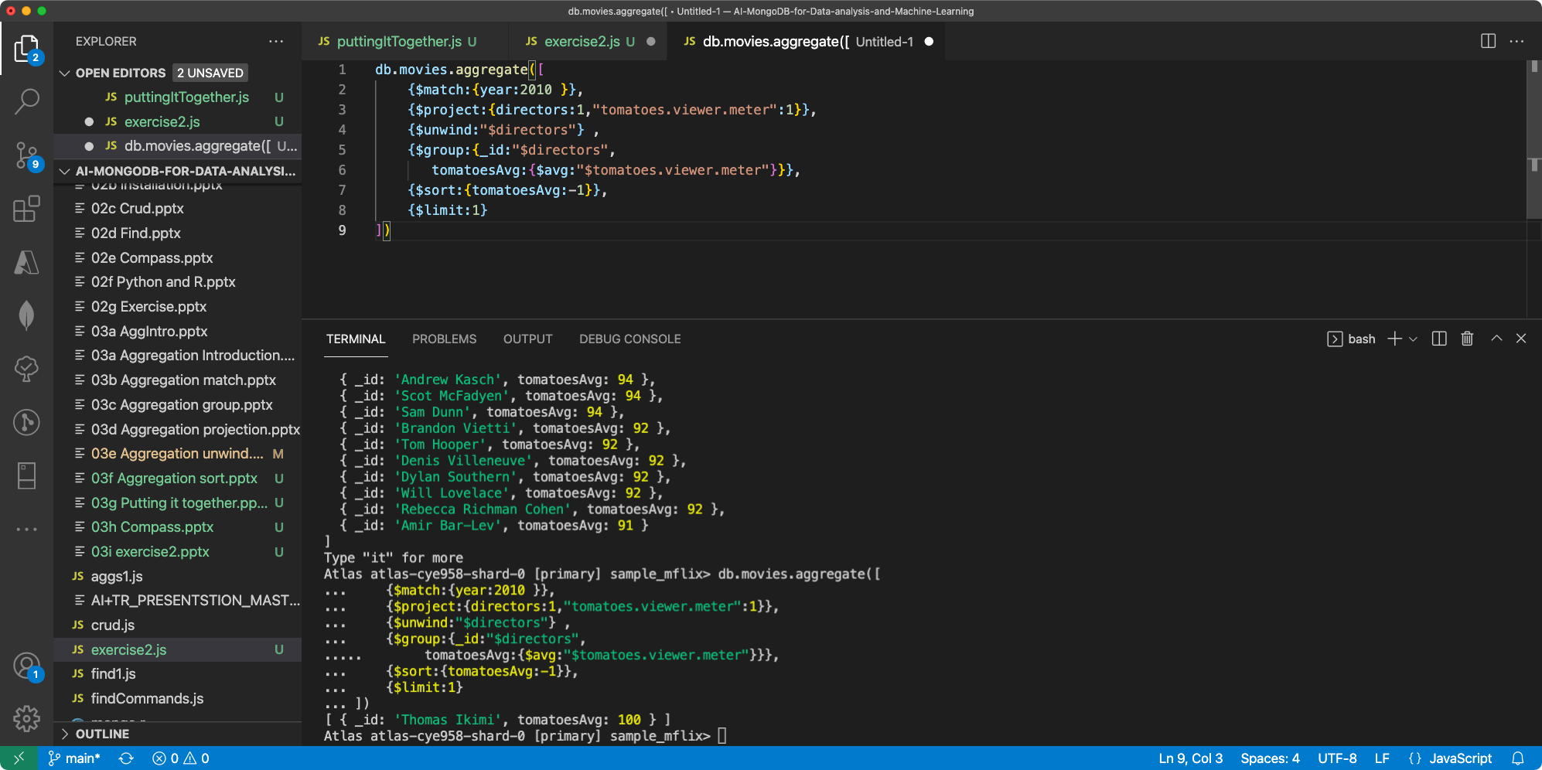

Slide 5
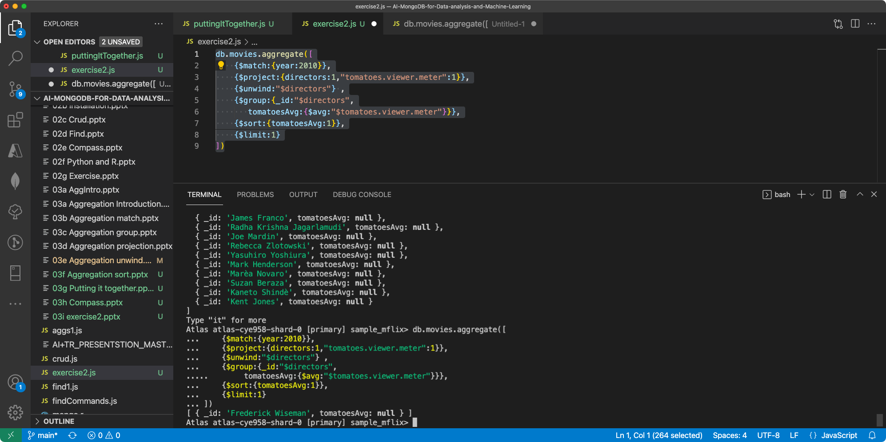

Slide 6
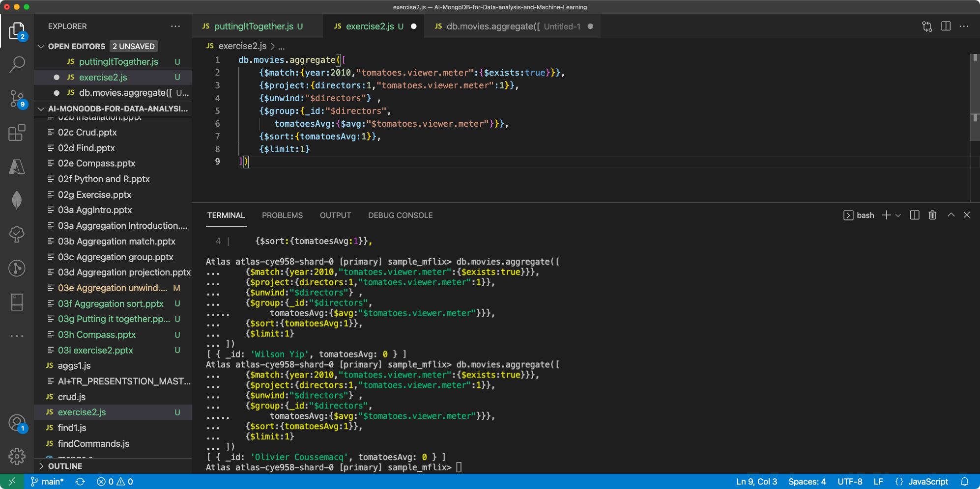

Slide 7
